Slide 1


Slide 2
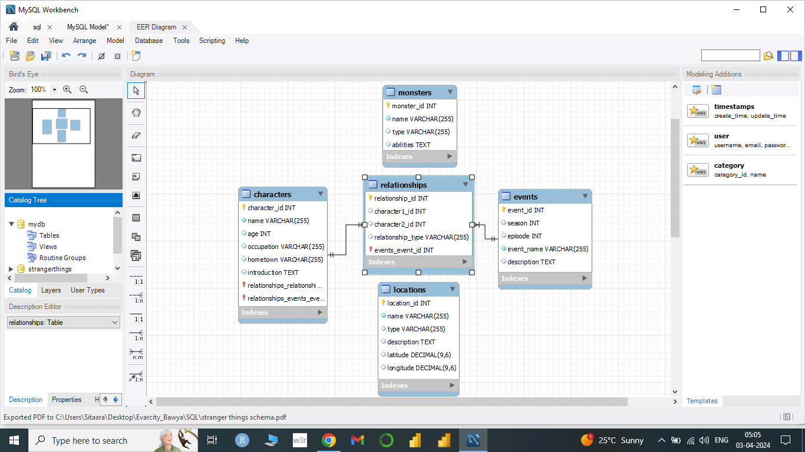
Table Schema:

Slide 3
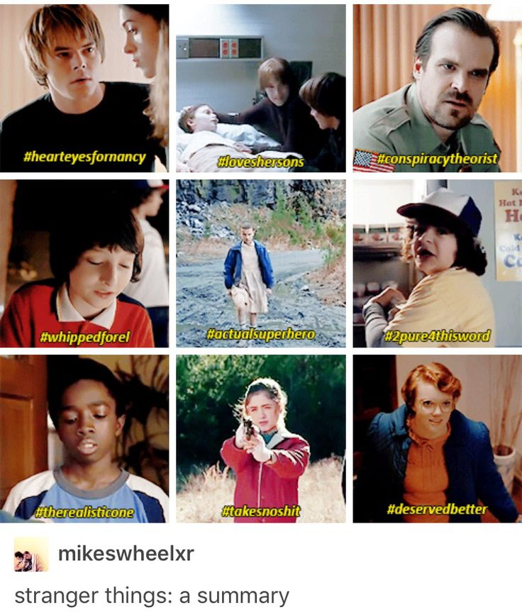
Characters :

Slide 4
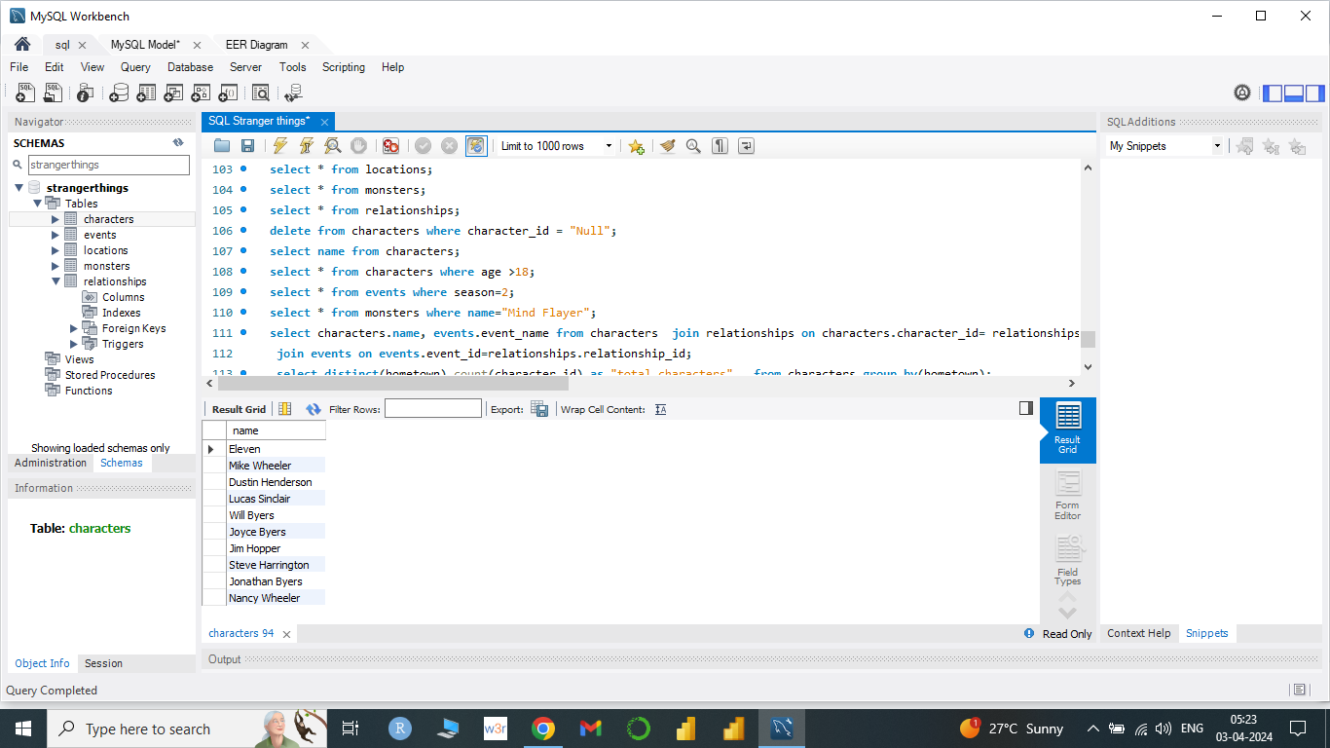
Question 1 :
Retrieve the names of the characters?
Answer :
select name from characters;

Slide 5
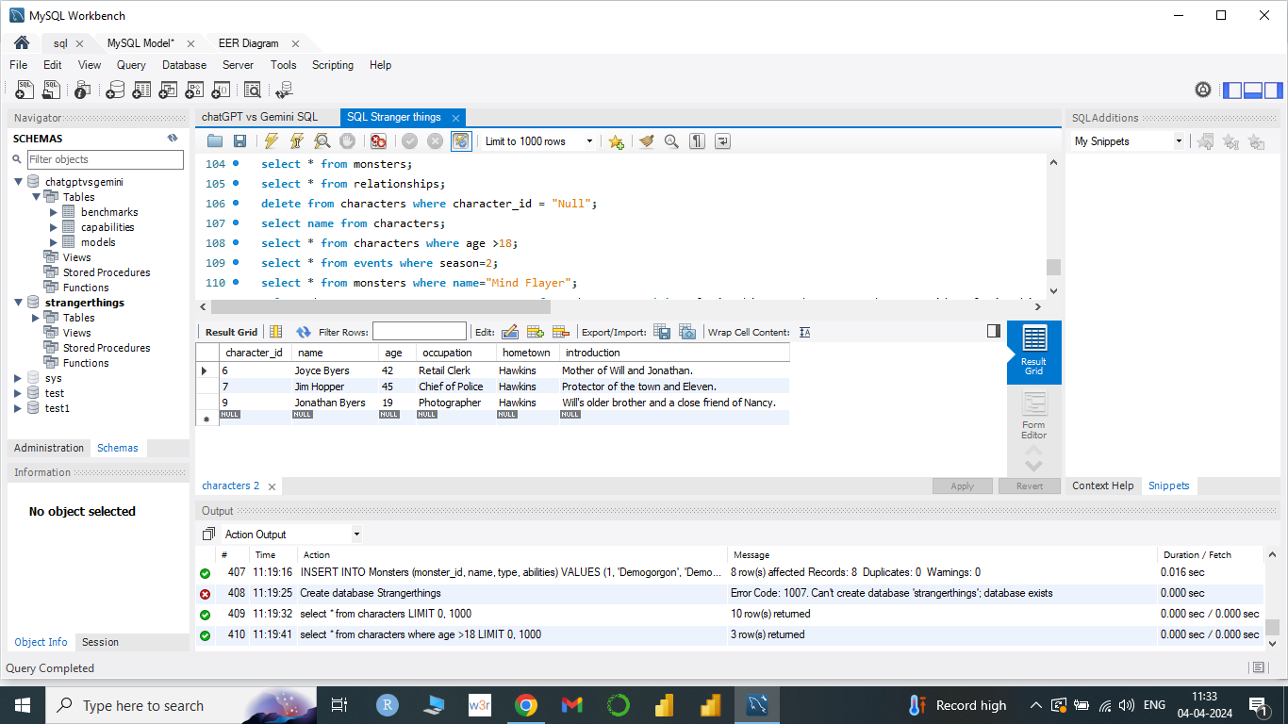
Question 2:
Find characters with age greater than 18?
Answer :
select * from characters where age>18;

Slide 6
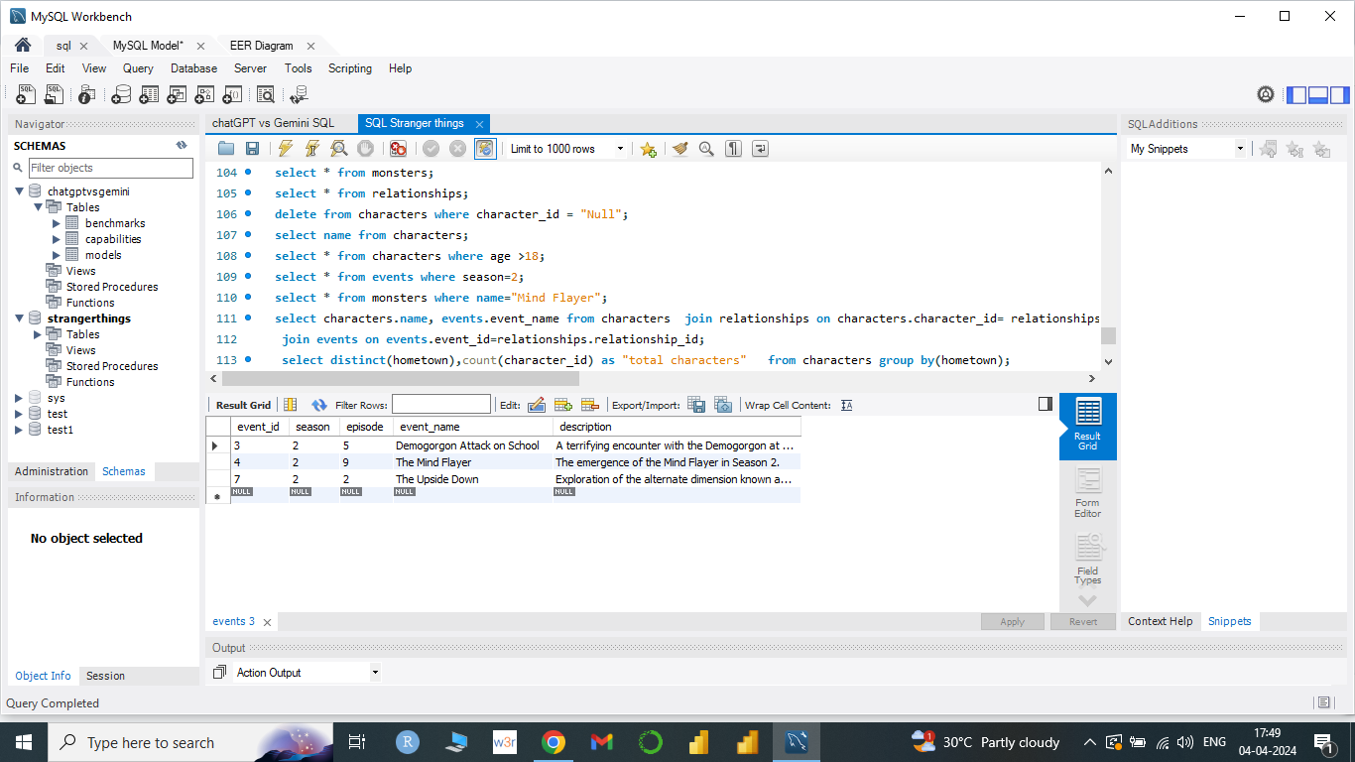
Question 3 :
Find events in Season 2?
Answer :
select * from events where season=2;

Slide 7
Question 1 :
Retrieve the names of the characters?
Answer :
select name from characters;

Slide 8
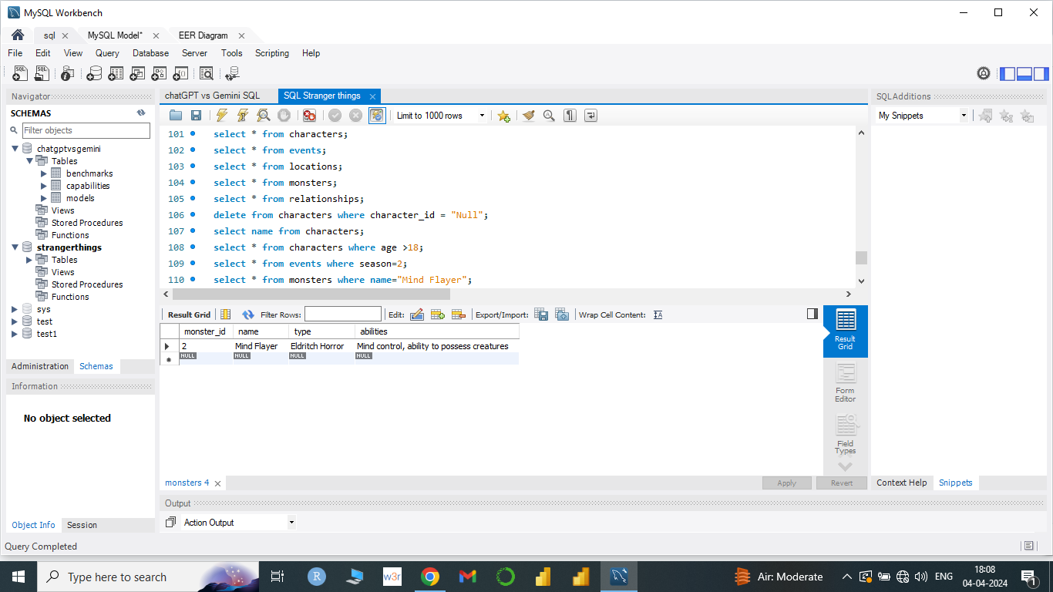
Question 4 :
Get details of the 'Mind Flayer' monster?
Answer :
select * from monsters
where name="Mind Flayer";

Slide 9
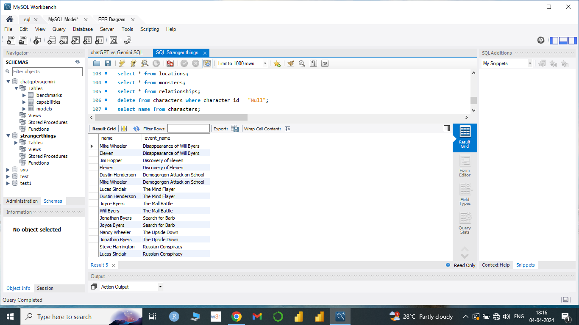
Question 5 :
Retrieve characters and their associated events?
Answer :
select characters.name, events.event_name from characters join relationships on characters.character_id= relationships.character1_id or characters.character_id= relationships.character2_id

Slide 10
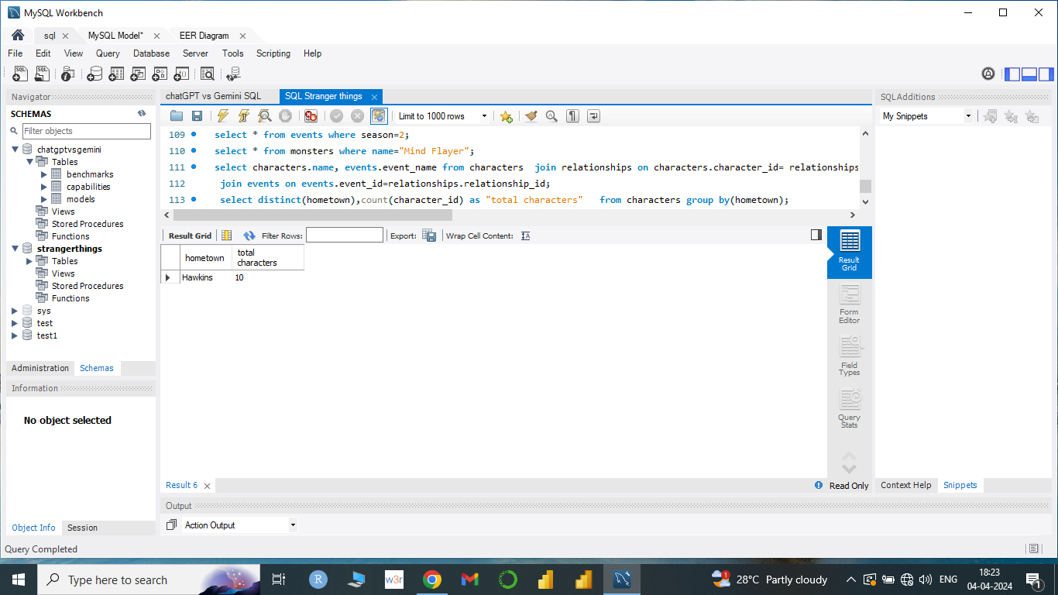
Question 6 :
Calculate the total number of characters from each hometown?
Answer :
select distinct(hometown),
count(character_id) as "total characters" from characters
group by(hometown);

Slide 11
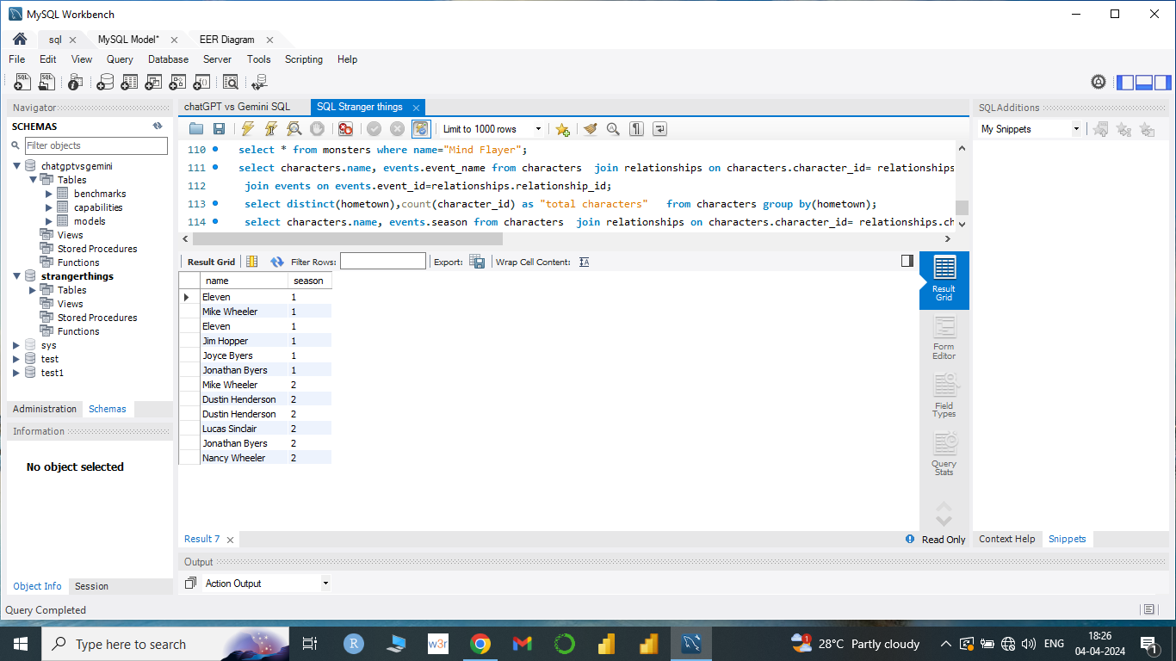
Question 7 :
Retrieve characters who were involved in events in Season 1 or Season 2?
Answer :
select characters.name, events.season from characters join relationships on characters.character_id= relationships.character1_id or characters.character_id= relationships.character2_id
join events on events.event_id=relationships.relationship_id where season in(1,2) order by season;

Slide 12
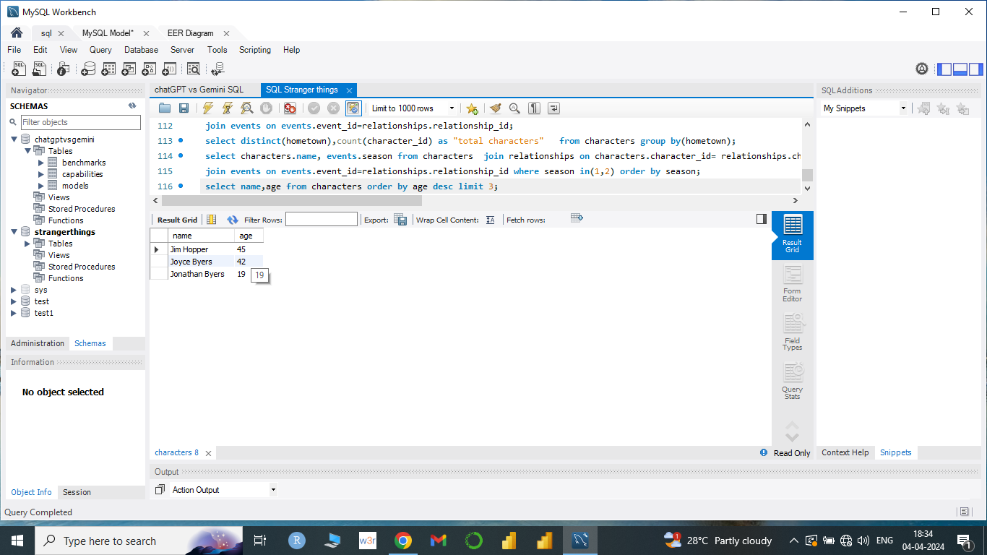
Question 8 :
Find the top 3 oldest characters?
Answer :
select name,age from characters order by age desc limit 3;

Slide 13
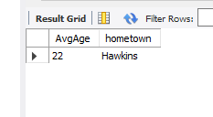
Question 9 :
Find the average age of characters in Hawkins?
Answer :
select round( avg(age)) as AvgAge, hometown from characters
where hometown="Hawkins";

Slide 14
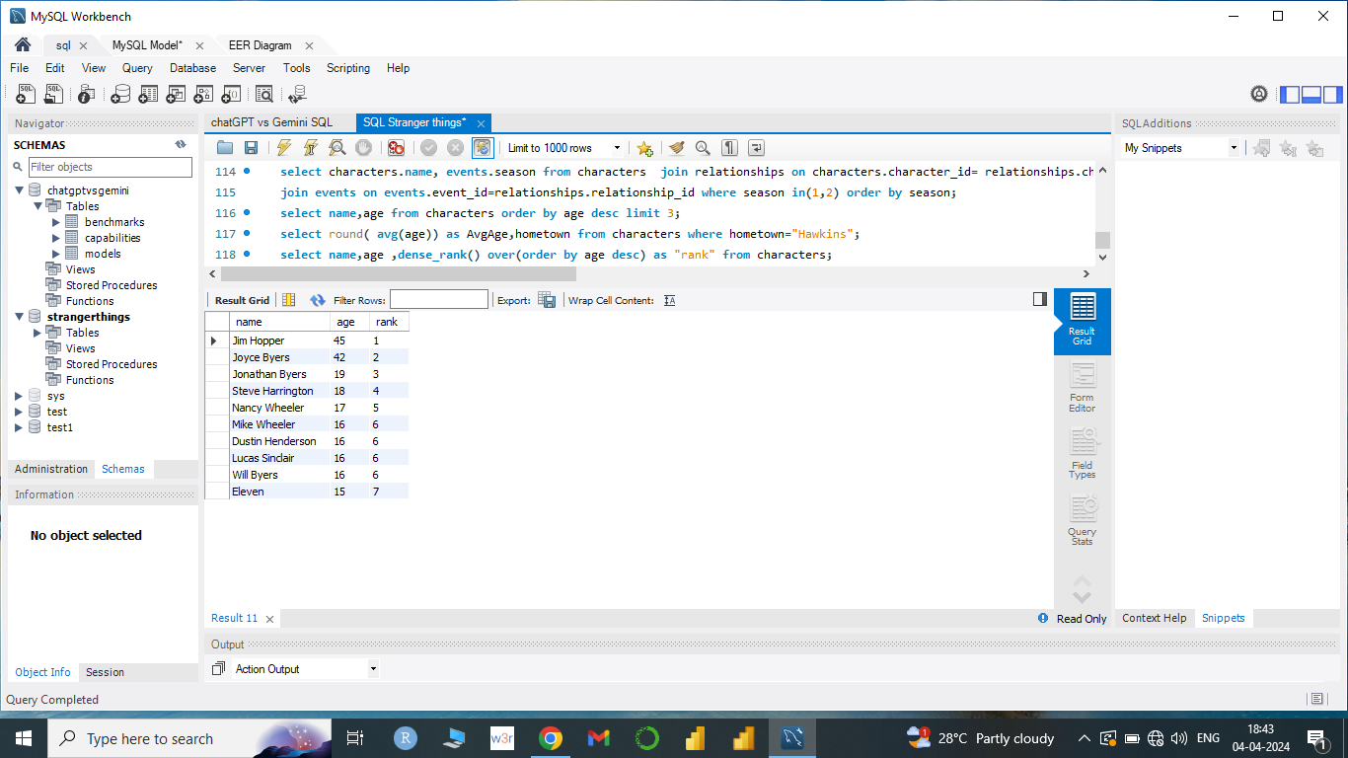
Question 10 :
Rank characters by age in descending order?
Answer :
select name,age ,
dense_rank() over(order by age desc) as "rank" from characters;

Slide 15

THANK YOU

